Slide 1




SANJIVANI COLLEGE OF ENGINEERING, KOPARGAON
Subject : Discrete Mathematics
Emergency Vehicle Priority Using Traffic Signal Synchronization
A mathematical approach using the Chinese Remainder Theorem.
Under the guidance of Prof. S. N. Gunjal
SMARTER TIMING • FASTER RESPONSE
TEAM
141 Saish Kale 142 Dnyaneshwari Avhad 143 Rutuja Kharate 157 Pranav Khilari
0125UCSM1141 0125UCSF1142 0125UCSF1143 0126UCSM2011

Slide 2






Introduction & Problem Statement
•
Why it matters
Problem Statement
1. Emergency vehicles such as ambulances, fire trucks, police vehicles, and rescue units require quick and safe passage during emergencies.
2. Repeated stops can delay critical medical and rescue response.
    Emergency Vehicle Priority Using Traffic Signal Synchronization (CRT-Based)
    This mini-project demonstrates how the Chinese Remainder Theorem (CRT) can be applied to real-time traffic signal control to give priority to emergency vehicles (ambulances, fire trucks, VIP convoys).
    By modeling traffic light cycles as modular congruences, the project calculates the optimal green signal timings along a route, allowing emergency vehicles to move without unnecessary stops, while still maintaining overall traffic flow.
Emergency Vehicles
Ambulances, fire trucks, police vehicles and rescue units need quick, safe passage during emergencies.
Signal Delays
Independent traffic signals and different cycle times can cause repeated stops and increase emergency response time.
CRT-Based Green Corridor
The Chinese Remainder Theorem (CRT) helps calculate suitable departure times to coordinate green signals along the route.
Emergency vehicle traversing pre-cleared green corridors

Slide 3






Objectives
Problem
01
Reduce response delays
Model signal timings
02
Coordinate signals along emergency routes to reduce unnecessary stops.
Represent cycle lengths, offsets and travel times with modular congruences.
    Traffic signals at different intersections operate with different cycle times and timings. When emergency vehicles such as ambulances, fire trucks, police vehicles, and rescue units travel through multiple intersections, they may encounter red signals and have to stop repeatedly.
    These delays can increase emergency response time and make it difficult for emergency vehicles to reach their destinations quickly.
03
Validate green windows
05
Support all emergency units
Check that arrivals fit within each intersection’s permitted green phase.
Include ambulances, fire and rescue, police and authorized emergency convoys.
06
Maintain safe traffic flow
03
Apply CRT
Balance priority passage with intersection safety and surrounding traffic.
Calculate suitable departure times that align repeating signal conditions.

Slide 4





Chinese Remainder Theorem (CRT)
01
What CRT does
Solves simultaneous congruences to find a time that satisfies multiple repeating signal cycles.
Chinese Remainder Theorem (CRT)
Solves simultaneous modular constraints for unified synchronization.
Modeling Periodic Cycles (Clock Math)
Traffic cycles reset after C seconds. Values wrap periodically around the modulus.
The Logic
Yields a single timeline value satisfying all known remainders simultaneously.
Congruence Notation
x ≡ a (mod m)
x and a leave identical remainders when divided by m.
The Condition
Moduli must be pairwise coprime (gcd(mᵢ, mⱼ) = 1) for guaranteed unique mathematical solutions.

Slide 5





Three-Intersection Corridor Synchronization
1. Intersection Congruences
2. Step-by-Step CRT Calculation
3. CRT Solution (t)
227 (mod 105)
Signal 1
t ≡ 2 (mod 5)
1
Total Modulus (M): M = 5 × 7 × 3 = 105
17
2
Partial Moduli (Mᵢ): M₁ = 21, M₂ = 15, M₃ = 35
Signal 2
t ≡ 3 (mod 7)
3
Modular Inverses (yᵢ): y₁ = 1, y₂ = 1, y₃ = 2
Smallest non-negative solution: t = 17
Signal 3
t ≡ 2 (mod 3)
17 ≡ 2 (mod 5) ✓
4. Solution Assembly (t):
(2×21×1) + (3×15×1) + (2×35×2) = 227
17 ≡ 3 (mod 7) ✓
Moduli {5, 7, 3} are pairwise coprime.
17 ≡ 2 (mod 3) ✓

Slide 6
CRT Worked Example: Set the Signal Conditions
STEP 1 • DEFINE THE CONDITIONS
We use three simple repeating conditions to demonstrate how the Chinese Remainder Theorem works.
SIGNAL 1
SIGNAL 2
SIGNAL 3
t ≡ 2 (mod 5)
t ≡ 3 (mod 7)
t ≡ 2 (mod 3)
When t is divided by 5, the remainder is 2.
When t is divided by 7, the remainder is 3.
When t is divided by 3, the remainder is 2.
CHECK THE MODULI
The moduli are 5, 7 and 3. They are pairwise coprime because each pair has no common factor other than 1.
Therefore, CRT gives one unique solution modulo 5 × 7 × 3 = 105.
EMERGENCY VEHICLE PRIORITY • CRT-BASED SYNCHRONIZATION

Slide 7
CRT Worked Example: Set the Signal Conditions
STEP 2 • CALCULATE
Find the total modulus, partial moduli and modular inverses before combining the equations.
1
Total modulus
M = 5 × 7 × 3 = 105
M₁ = 105 ÷ 5 = 21 • M₂ = 105 ÷ 7 = 15 • M₃ = 105 ÷ 3 = 35
2
Partial moduli
21 ≡ 1 (mod 5), so y₁ = 1
15 ≡ 1 (mod 7), so y₂ = 1
35 ≡ 2 (mod 3), so y₃ = 2
3
Modular inverses
Remember:
A modular inverse makes the product leave remainder 1 when divided by its modulus.
EMERGENCY VEHICLE PRIORITY • CRT-BASED SYNCHRONIZATION

Slide 8
CRT Worked Example: Set the Signal Conditions
STEP 3 • SOLVE AND VERIFY
Combine the three terms, reduce modulo 105, and verify that the result satisfies every condition.
t = 42 + 45 + 140 = 227
227 = 2 × 105 + 17
COMBINE THE TERMS
REDUCE MODULO 105
t = (2 × 21 × 1) + (3 × 15 × 1) + (2 × 35 × 2)
t ≡ 17 (mod 105)
VERIFY THE SOLUTION
✓ 17 ÷ 5 leaves remainder 2
✓ 17 ÷ 7 leaves remainder 3
✓ 17 ÷ 3 leaves remainder 2
17 ≡ 2 (mod 5)
17 ≡ 3 (mod 7)
17 ≡ 2 (mod 3)
RESULT: t = 17 is the smallest non-negative solution. Other solutions are 122, 227, 332, …
This is a solution to the assumed equations—not automatically a real ambulance departure time.
EMERGENCY VEHICLE PRIORITY • CRT-BASED SYNCHRONIZATION

Slide 9




MATHEMATICAL FORMULATION & SAFETY
Congruence Mapping & Green-Window Safety
TARGET PHASE
CRITICAL SAFETY CHECK
Arrival Time Calculation:
T + Dᵢ ≡ Oᵢ + rᵢ (mod Cᵢ)
Green-Window Feasibility
We must verify that computed arrival time falls within physical green duration.
0 ≤ (tᵢ - Oᵢ) mod Cᵢ < Gᵢ
Solving for Departure (T):
T ≡ Oᵢ + rᵢ - Dᵢ (mod Cᵢ)
T: Departure | Dᵢ: Travel Delay | Oᵢ: Offset | rᵢ: Green Target | Cᵢ: Cycle

Slide 10



Architecture & Data Flow
1. Inputs
2. Solver
3. Validation
4. Output
Cycle lengths, offsets (Cᵢ, Oᵢ, Dᵢ).
Generate & solve CRT congruences.
Green-window bounds feasibility check.
Feasible departure schedule & green wave.

Slide 11
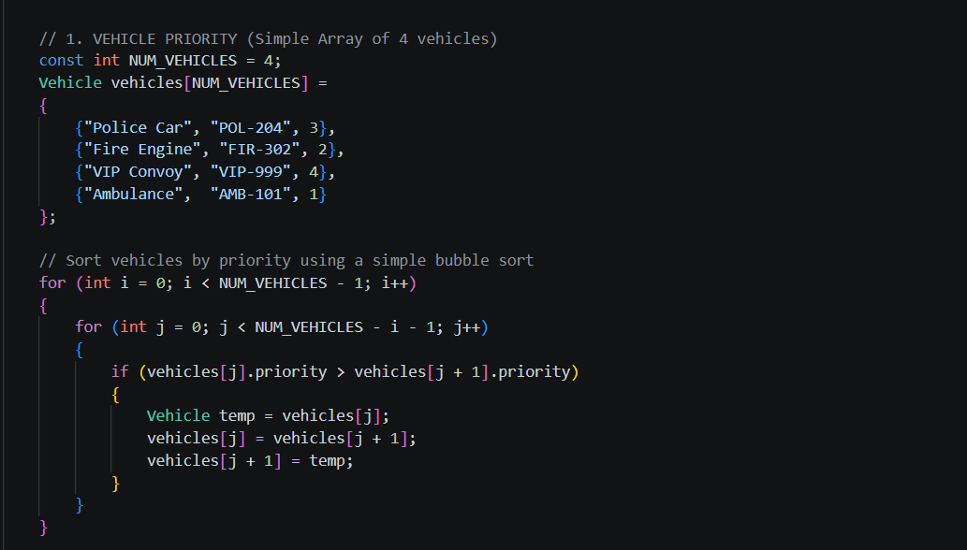
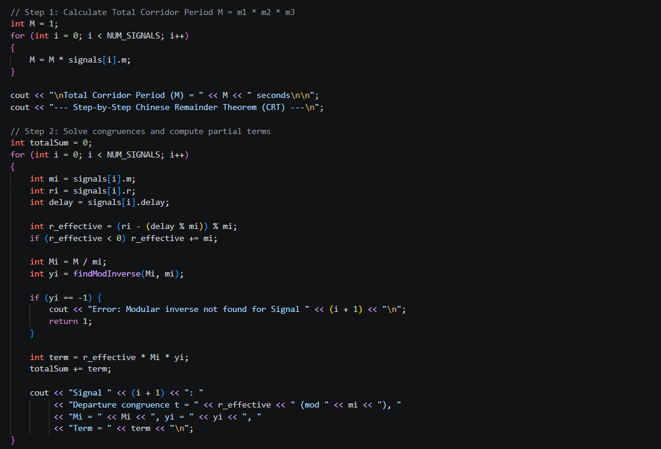
C++ Solver Implementation

Slide 12
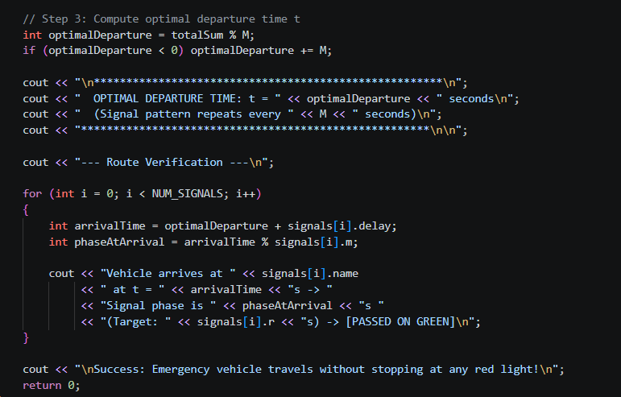
C++ Solver Implementation

Slide 13
Applications
Applications of the Project
  Ambulance Management: Helps reduce delays at traffic signals and supports faster transportation of patients.
  Fire Brigade Services: Helps fire engines reach emergency locations with fewer traffic signal delays.
  Police Emergency Response: Supports smoother movement of police vehicles during emergencies.
  Smart Traffic Management: Can be integrated into intelligent traffic systems to coordinate traffic signal timings.
  Smart City Development: Provides a foundation for developing technology-based emergency vehicle coordination systems.

Slide 14



Advantages & Limitations
Advantages
Limitations
• Clear mathematical modeling
Rigorous foundation using number theory and modular congruences.
• Assumes constant travel velocities
Calculations model uniform vehicle transit speeds between intersections.
• Reproducible timing structures
Deterministic departure schedules with provable consistency.
• Ignores unexpected congestion
Real-world traffic bottlenecks can cause temporal drift from ideal schedules.
• Zero physical hardware cost
Achieves synchronization through calculation rather than expensive roadside transponders.
• Incompatible modular congruences
Non-coprime cycles with conflicting remainders require fallback heuristics.

Slide 15




Future Scope & Expansions
Live GPS Data
Adaptive Signals
Multi-Vehicle Priority
Dynamic calculation of Dᵢ travel metrics using connected vehicle telemetry.
Controller integration for fluctuating cycle times and on-the-fly micro-adjustments.
Fleet-wide synchronization managing complex concurrent emergency transit routes.

Slide 16


Thank You

